Slide 1



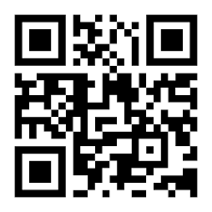

DEVELOPING QR CODE SCANNER FOR SMART BUS TICKETING SYSTEM
MAHAVEER INSTITUTE OF SCIENCE AND TECHNOLOGY
PRESENTED BY
AKULA SAI JAHNAVI[17E31A1201]
YASMEEN BEGUM[17E31A1233]

Slide 2
CONTENT
INTRODUCTION
EXISTING SYSTEM
LIMITATION OF EXISTING SYSTEM
PROPOSED SYSTEM
OBJECTIVES
SCOPE
LIMITATION OF PROPOSED SYSTEM
COMPARISON OF QR CODE VS BARCODE
LITERATURE REVIEW
REQUIREMENT ANALYSIS
EXPECTED RESULT
ALGORITHM OF QR IMAGE
IMPLEMENTATION
SYSTEM TESTING
SYSTEM ARCHITECTURE
SYSTEM DESIGNING
APPLICATION USER INTERFACE
FUTURE ENHANCEMENT
CONCLUSION
REFERENCES

Slide 3
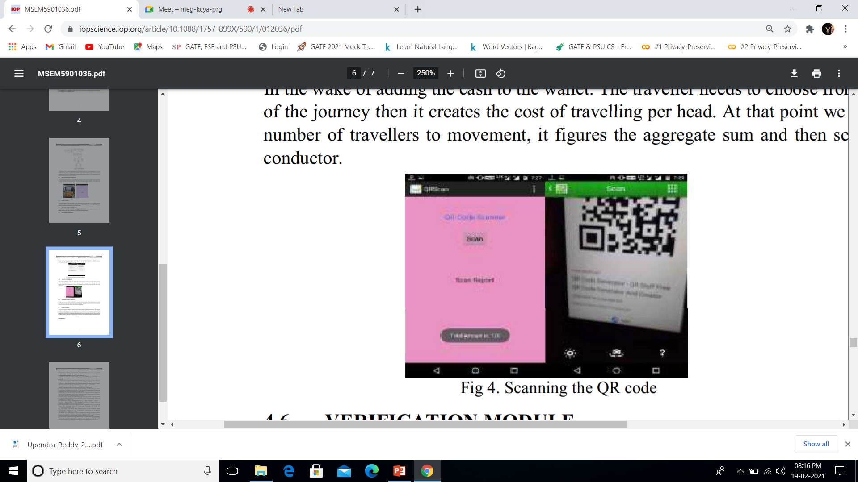
INTRODUCTION
Smart Bus Ticket Using QR Code is a mobile application.
This new system will support the ecogreen campaign that urged by the government with using less paper.
It will improve the current system by using QR code whereby it is more efficient for the customer to keep the ticket.

Slide 4
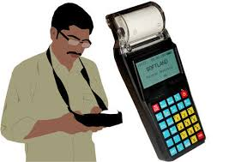
EXISTING SYSTEM
In the general way, every bus is supervised by a conductor.
The conductor will collect money from each passenger and issue ticket.
Initially, printed papers or tokens are used as tickets.
Nowadays, handheld machines are used to print tickets.
This system has many disadvantages

Slide 5
LIMITATION OF EXISTING SYSTEM
Passengers might lose the printed tickets purchased from the conductor
Conductor has to go to each and every passenger to provide tickets and it is not very convenient as it takes much time and effort.
In manual System, staff need to print the ticket during purchasing process.
This will require a relatively high cost to buy paper and to print the tickets.
In midst of this pandemic situation, existing system might become the reason or might propagate more physical contact between the passengers which would lead to huge risk.

Slide 6
PROPOSED SYSTEM
In our proposed system , we are introducing QR reader.
Here, we will create one android application for select travelling route and generate amount.
After generating amount, user has to read that QR image.
Then automatically it will transfer amount from our bank account or wallet.
Here the admin has a QR reader and after reading the values it will automatically store in database.
Then user will get message for travelling ticket.

Slide 7
OBJECTIVE
To develop an application that utilizes QR-Code that supports express bus integrated e-ticket.
To improves the management process in generating reports easily and systematically.
To test functionality of Smart Bus Ticket(SmartBus).

Slide 8
SCOPE
Users
– View ticket
– View destination
– Edit profile
– Add Bank details
Admin
– collect data
– Analyze data
– Update data
Technology
– QR Code

Slide 9
LIMITATION OF PROPOSED SYSTEM
Passenger who does not sign up in this app cannot buy a bus ticket.
Passenger cannot change their seat after completion of their payment.
If passenger does not possess a smart device then ,he cannot buy the ticket through the app.

Slide 10
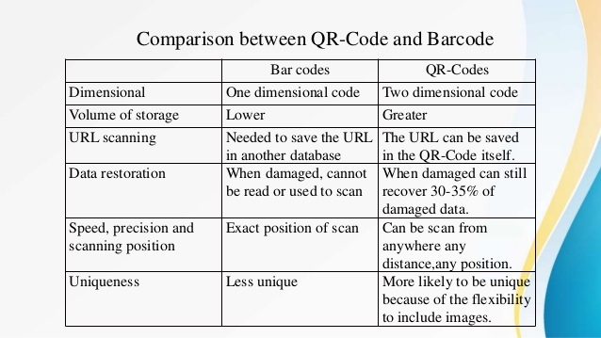
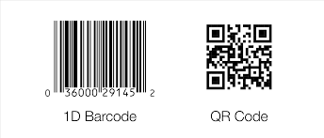
Comparison between QR-Code and Barcode

Slide 11
LITERATURE REVIEW
QR-Code is one of the type of matrix barcode.
QR codes are a low-threshold technology , Low-cost, easy to implement, and easy to use.
The QR code is immediately created and can be copied and saved.

Slide 12
REQUIREMENT ANALYSIS
- Hardware Requirement Specification
OS – Windows 7, 8
RAM – Min 4GB
Android Mobile
- Software Requirement Specification
JDK
Android Eclipse (ADT-Bundle)
Net beans IDE
Mysql and SQLyog

Slide 13
EXPECTED RESULT
Passengers are able to make their booking through passenger's mobile phone.
To achieve the objective for this system ,which is to implement the application for the users
To improve the management process in generating reports easily and systematically.

Slide 14
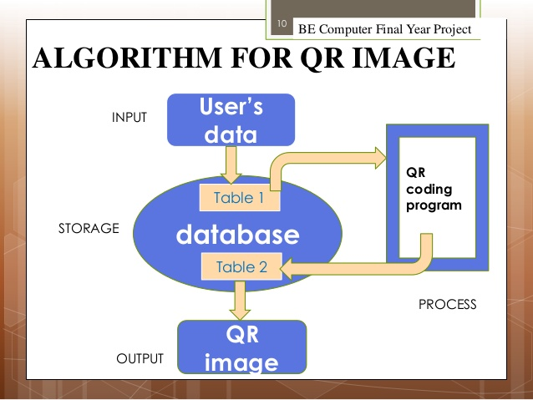
ALGORITHM FOR QR IMAGE

Slide 15
IMPLEMENTATION
Android application easier to install and configure
Properly functioning on both Android and IOS devices
User Concerns
Friendly services
Quick access to service
Can easily retrieve the data
Operation of the system fit into day to day services
Designer Concerns
Identifying the users device’s IMEI
Easier handling of system to perform this function
Efficient ways of storing this data and images

Slide 16
SYSTEM TESTING
Unit Testing
Integration Testing
Acceptance Testing
Testing Strategies:-
i. White Box Testing
ii. Black Box Testing

Slide 17
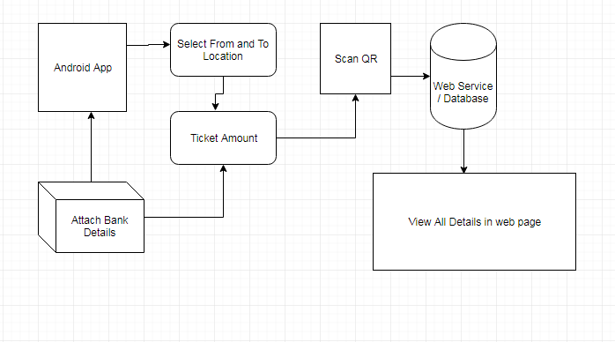
SYSTEM ARCHITECTURE

Slide 18
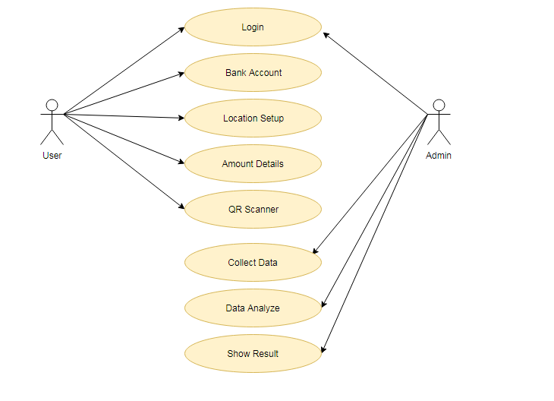
SYSTEM DESIGNING
Use Case Diagram:

Slide 19
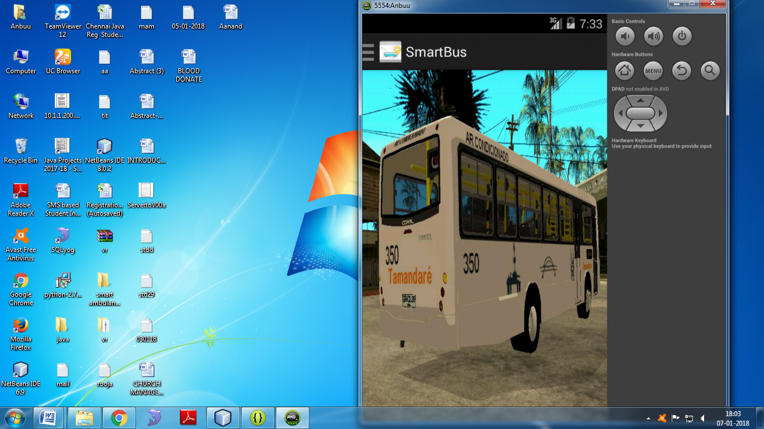
APPLICATION USER INTERFACE

Slide 20
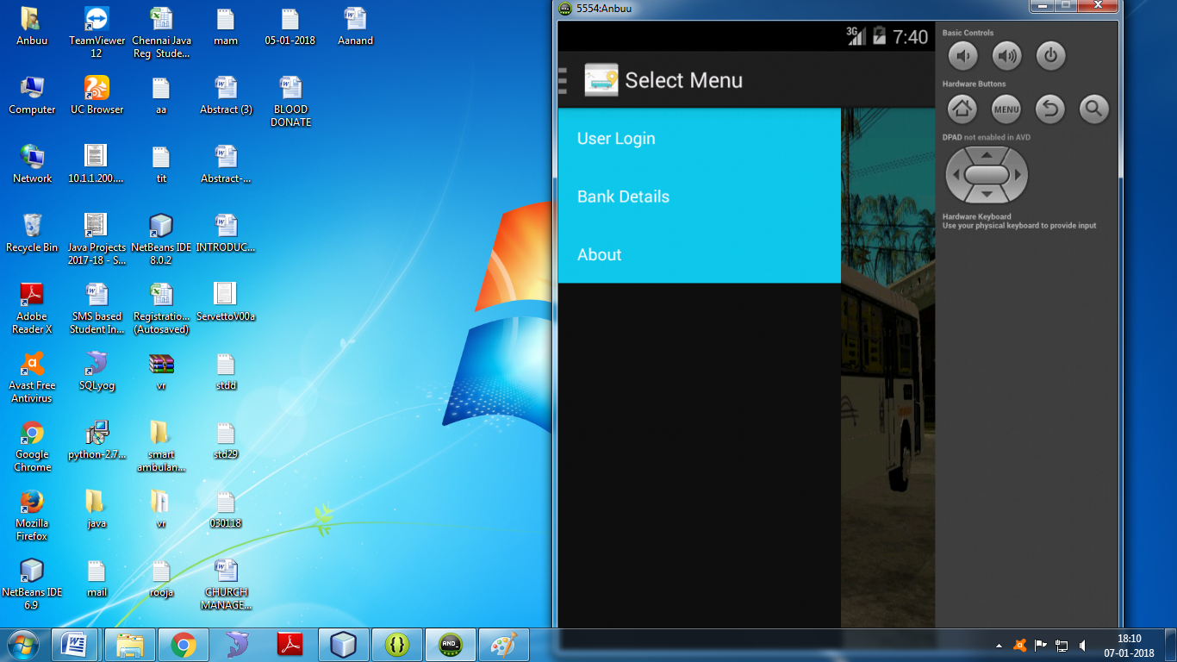

Slide 21
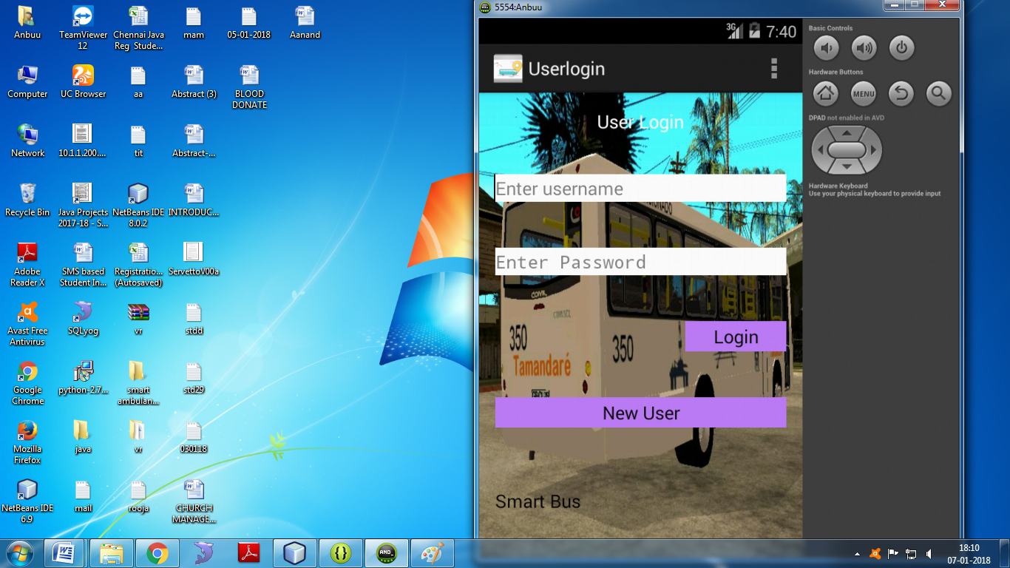

Slide 22
FUTURE ENHANCEMENT
We will make updates in design and features
We propose smart bus tracking system that any passenger with a smart phone or mobile device with the QR (Quick Response) code reader can scan
The QR codes placed at bus stops to view estimated bus arrival times, buses’ current locations, and bus routes on a map.

Slide 23
CONCLUSION
To summarizes the current issues in bus ticketing system.
To overcome from this we are working towards android platform.
We have identified the current gaps and open research areas.
To overcome the drawbacks of manual ticketing system we are using QR-Code for security purpose of passengers information in the propose system.

Slide 24
REFERENCE
Z. Wei, Y. Song, H. Liu, Y. Sheng, X. Wang, "The research and implementation of GPS intelligent transmission strategy based on on-board Android smartphones", Computer Science and Network Technology (ICCSNT) 2013 3rd International Conference on, pp. 1230-1233, 2013.
L. Singla, P. Bhatia, "GPS based bus tracking system", Computer Communication and Control (IC4) 2015 International Conference on, pp. 1-6, 2015.
Foisal Mahedi Hasan et al., "RFID-based Ticketing for Public Transport System: Perspective Megacity Dhaka", 3rd IEEE International Conference on Computer Science and Information Technology (ICCSIT), vol. 6, pp. 459-462, 2010.

Slide 25


